Slide 1

Test Design Techniques
Sul
OKSANA

Slide 2
Equivalence partitioning and Boundary value analysis
To have ability to buy products on web store user should register his login name on web registration page. The field for entering login name should contain letters only, to be no shorter than 4 characters, to be no longer than 10 characters. Login names which do not meet requirements will not be allowed.

Slide 3
Equivalence partitioning and Boundary value analysis
 | Invalid | Valid | Invalid
Class (number of alphabetic characters ) | <4 | From 4 to 10 | >=11
BVA | 3 | 4 6 10 | 11
Invalid class: number and special symbols.

Slide 4
# | Test Item | Test Data
1. | Correct login name | 1. Any number of alphabetic characters (from 4 to 10) 2. 4 alphabetic characters 3. 10 alphabetic characters
2. | Please, write longer name | < 4 alphabetic characters (3)
3. | Please, write shorter name | >10 alphabetic characters (11)
4. | Please, write corect name | Any numbers( e.g. -5, e.g. 14.4, e.g. 34,5) Any spesial characters Any combination of numbers and alphabetic characters Any combination of numbers and spesial characters Any combination of spesial characters and alphabetic characters
5. | Please, write your name | The filed is empty

Slide 5
Decision tables
If you are creating new Amazon account, you will get a 10% discount on all your purchases today. If you are an existing customer and you hold a Premium card, you get a 5% discount. If you have a coupon, you can get 15% off today (but it can't be used for people who created account in the same day).

Slide 6
Causes (inputs) | R1 | R2 | R3 | R4 | R5 | R6 | R7 | R8
If you new customer and buy today ? | Y | Y | Y | Y | N | N | N | N
If you hold a Premium card and buy today? | Y | Y | N | N | Y | Y | N | N
If you have a coupon and buy today? | Y | N | Y | N | Y | N | Y | N
Discount (%) | - | - | 10 | 10 | 20 | 5 | 15 | 0
Message * | + | +

Slide 7
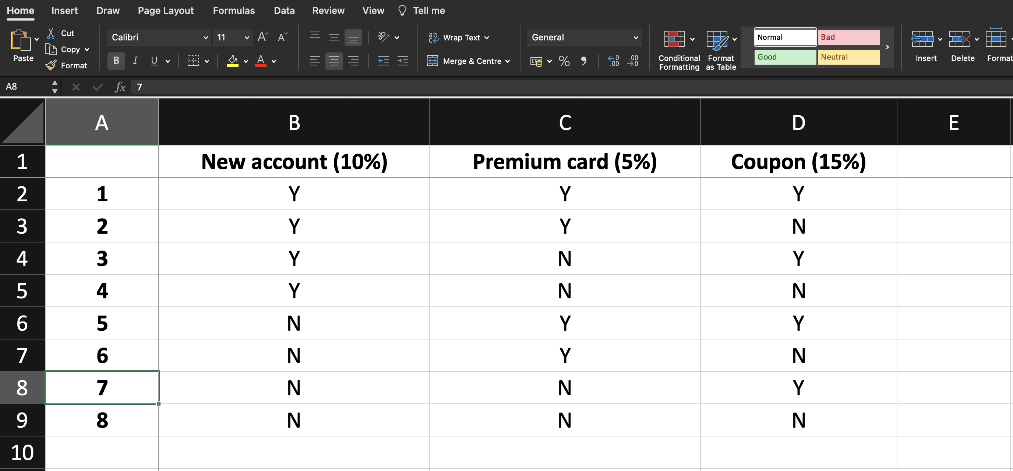
Generate pairwisetool (All Combinations)

Slide 8
# | Condition | Outcome
1. | A person is having new Amazon account & hold a Premium card & having coupon | Error Message
2. | A person is having new Amazon account & hold a Premium card | Error Message
3. | A person is having new Amazon account & having coupon | 10% discount given to the person having new Amazon account & buy today. Coupon can't be used for people who created account in the same day
4. | A person is having new Amazon account | 10% discount given to the person having new Amazon account & buy today
5. | A person is having Premium card & having coupon | 20% discount given to the person having Premium card & having a coupon & buy today
6. | A person is having Premium card | 5% discount given to the person havinga Premium card & buy today
7. | A person is having coupon & buy today | 15% discount given to the person having a coupon & buy today

Slide 9
State transition
You are using sending money option in mobile account. You enters amount of money he likes to send, types mobile number and click ‘Send’. If entered amount of money is allowed and phone number format is correct, then money will be sent and user will get appropriate message. If sum of replenishment is too low or too high, then user should re-enter it. If phone number format is incorrect, then user should enter correct phone number.

Slide 10
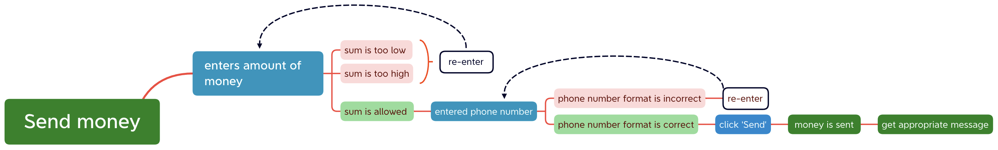
State transition

Slide 11
Positive

Slide 12
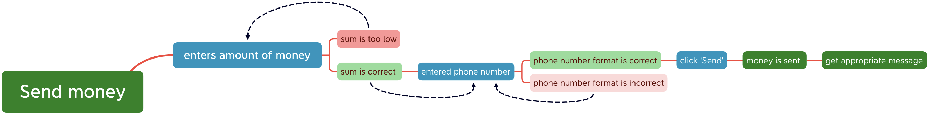
Negative

Slide 13
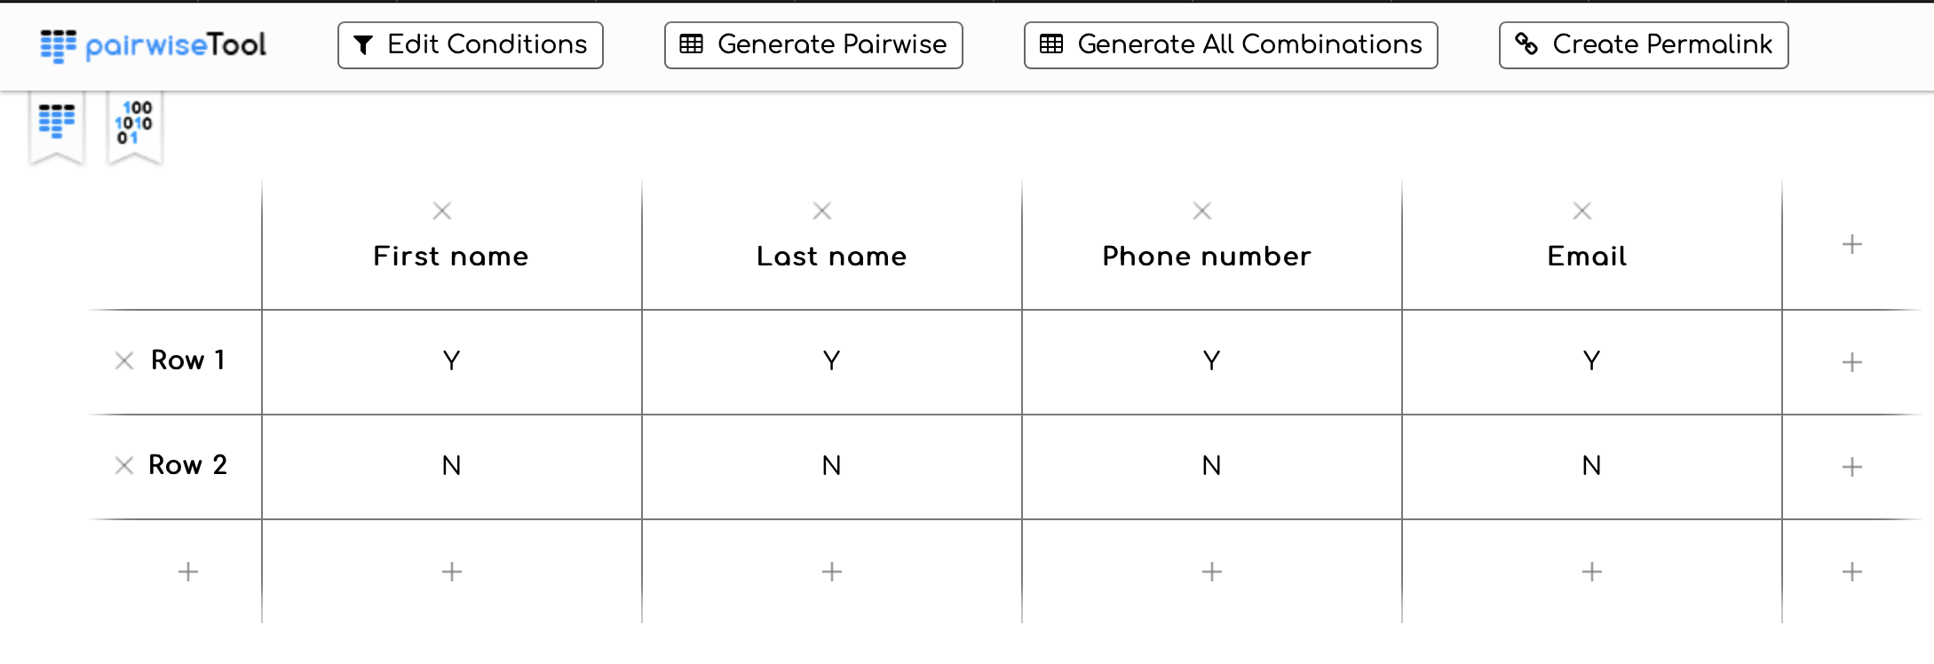
Pairwise (Use pairwisetool)

Slide 14
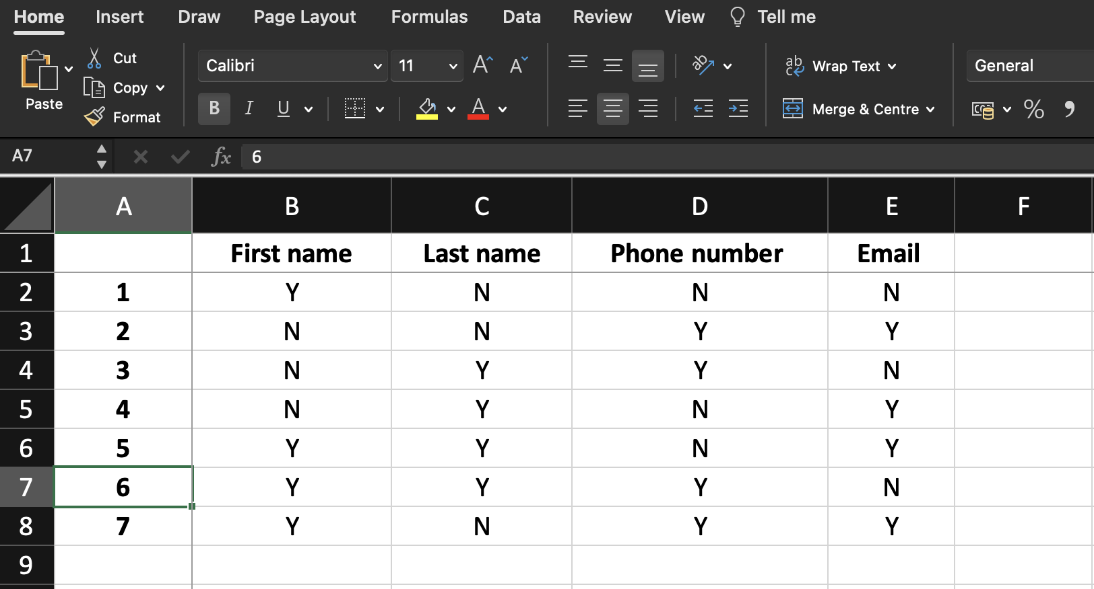
Generate pairwisetool

Slide 15
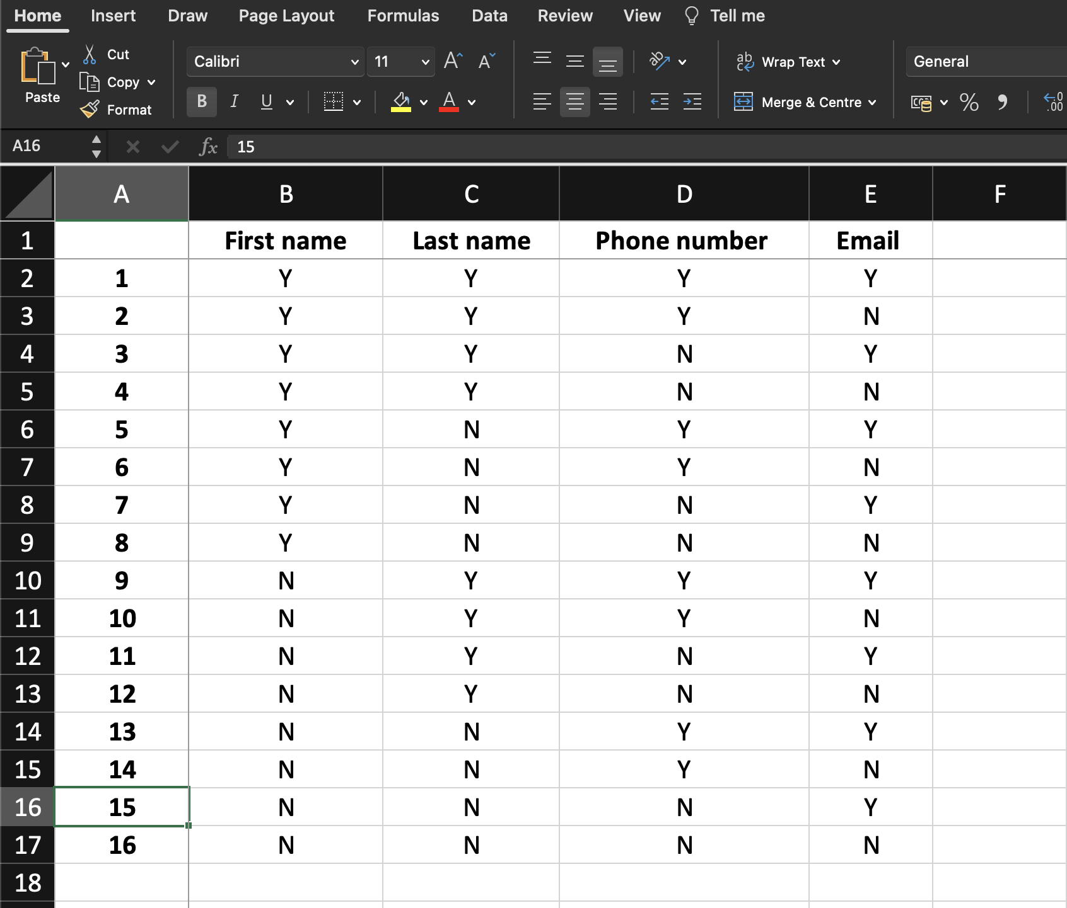
Generate All Combinations

Slide 16



